Slide 1
MANTIS HRIS
JOHANN PAUL ALPAPARA
JERI LUTHER GENERAL
JUSTINE MARK SICCION

Slide 2
Introduction

Slide 3
Review of Related Literature/Systems

Slide 4
Technical Background

Slide 5
Methodology, Results and Discussion

Slide 6
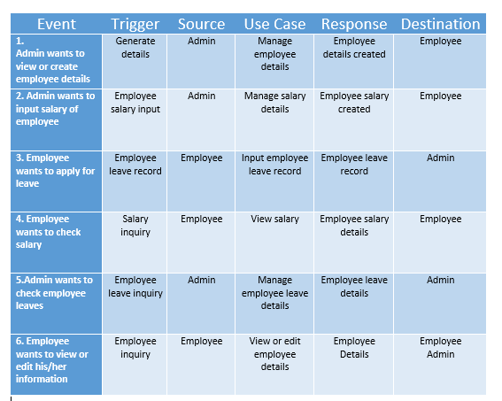
Event Table

Slide 7
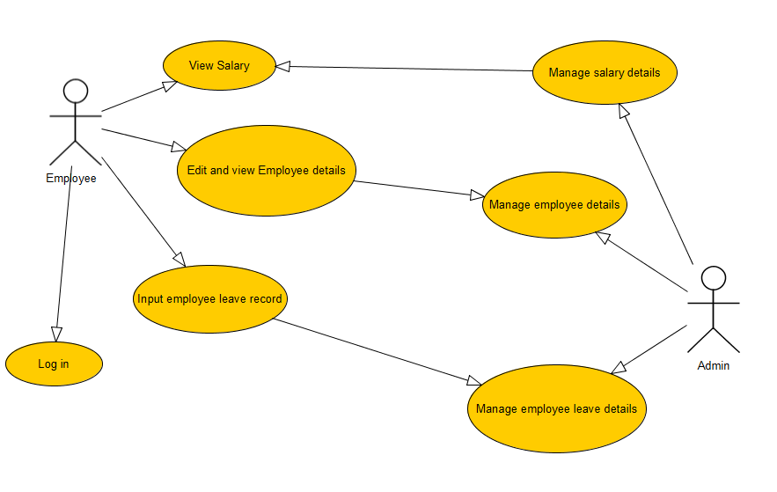
Use case

Slide 8
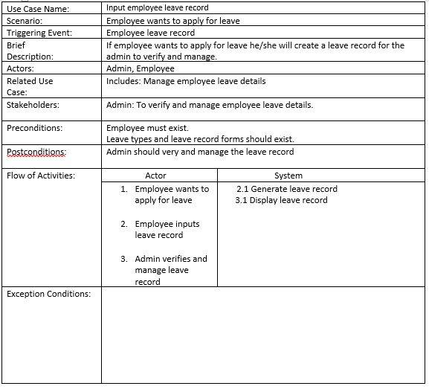
Use case full description

Slide 9
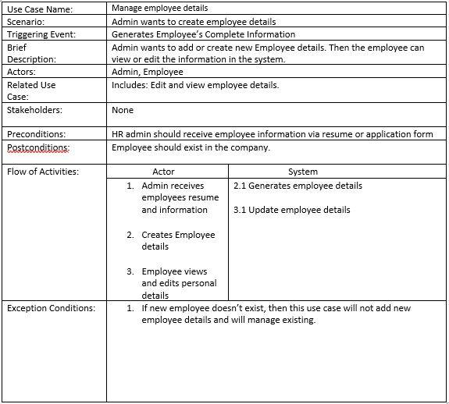
Use case full description

Slide 10
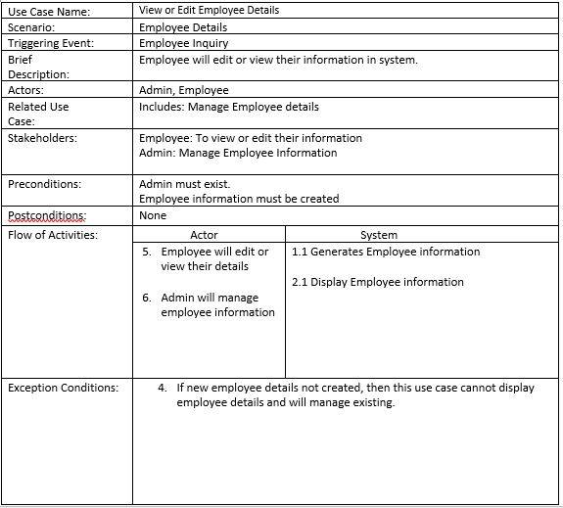
Use case full description

Slide 11
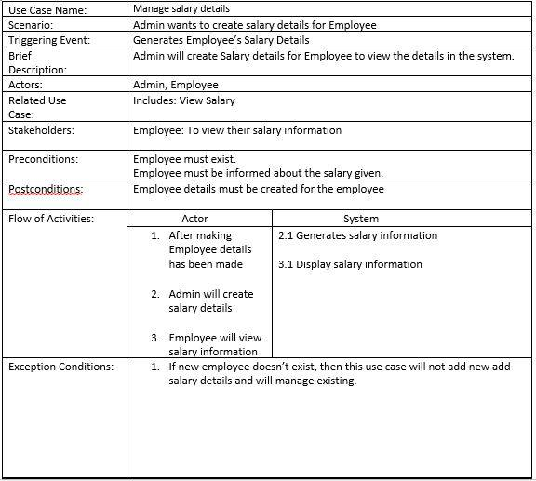
Use case full description

Slide 12
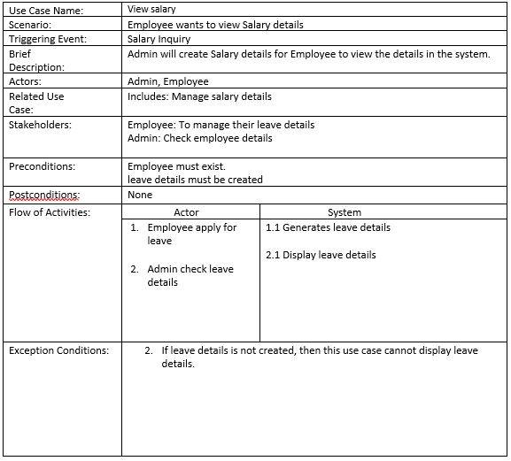
Use case full description

Slide 13
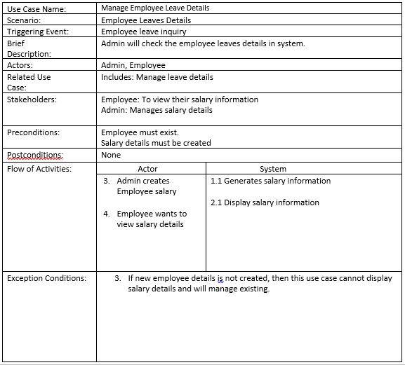
Use case full description

Slide 14
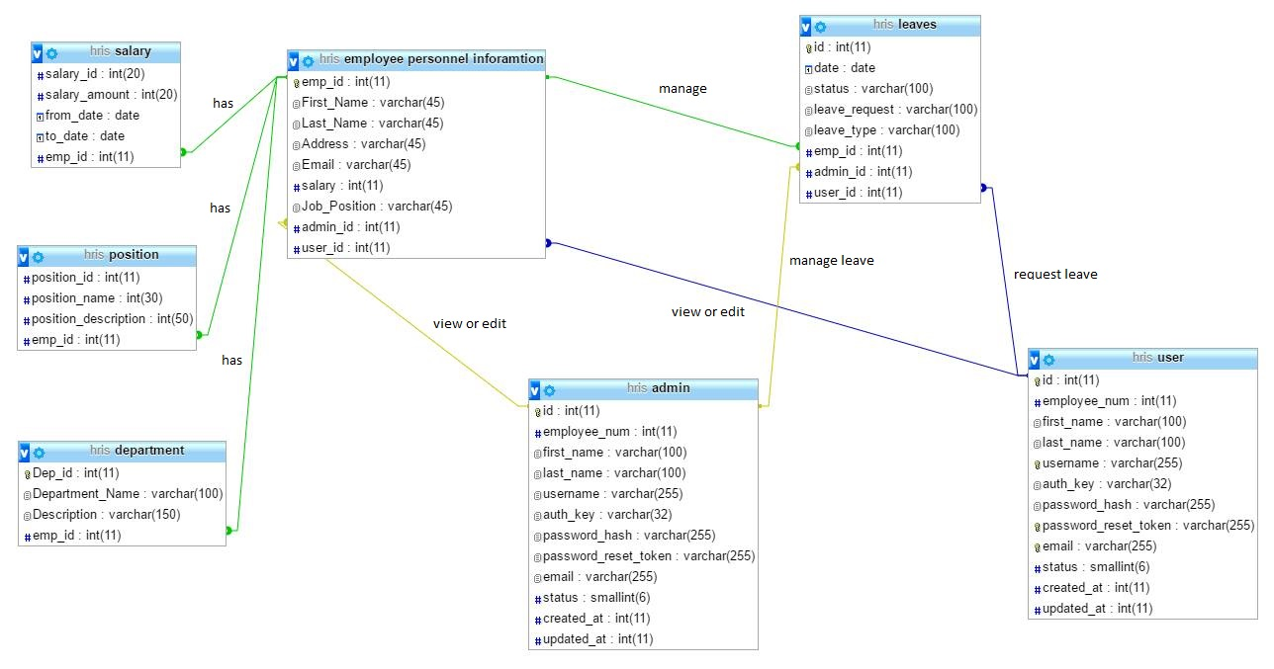
Entity relationship diagram

Slide 15
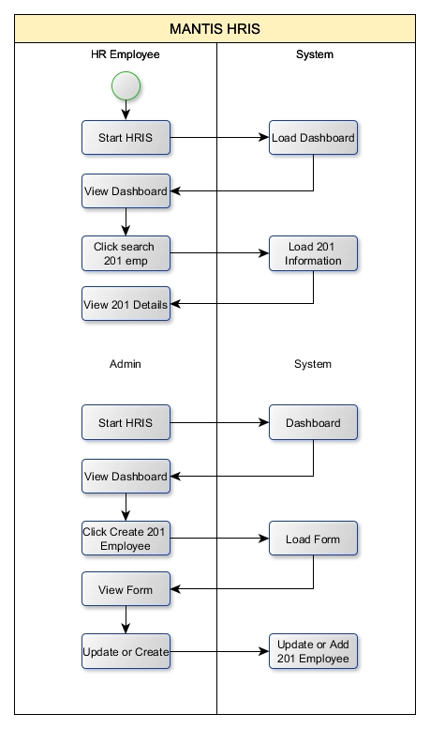
Activity Diagram

Slide 16
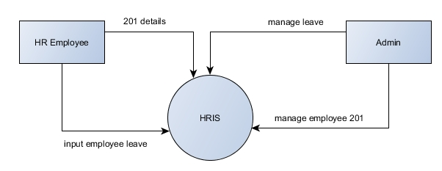
Context Diagram

Slide 17
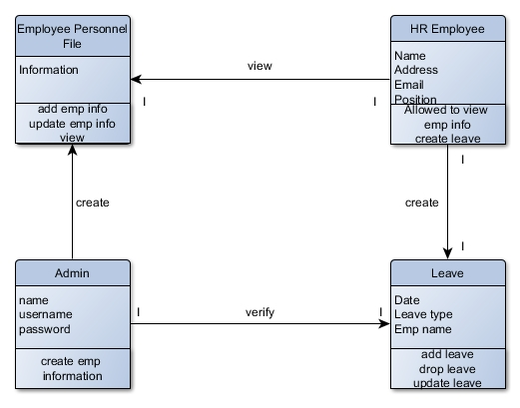
Class Diagram

Slide 18
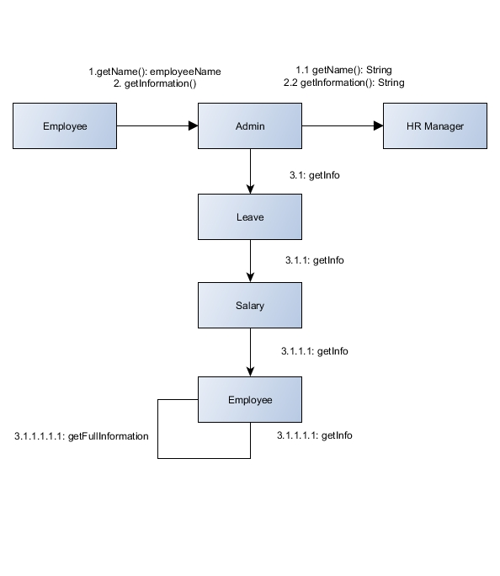
Communication Diagram

Slide 19
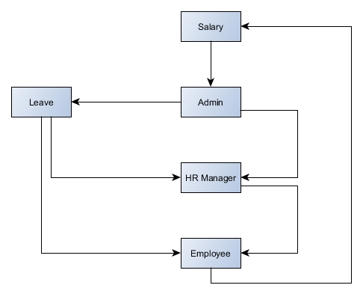
Component Diagram

Slide 20
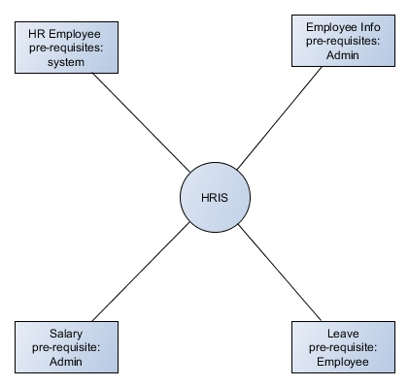
Composite Diagram

Slide 21
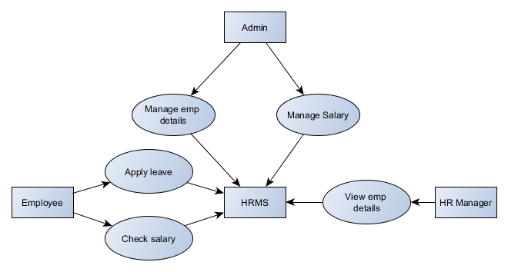
Data flow diagram

Slide 22
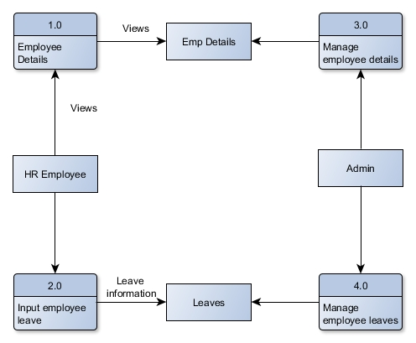
diagrams

Slide 23
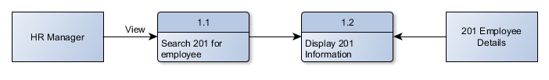
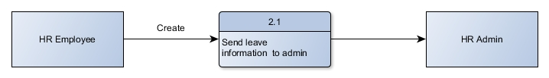
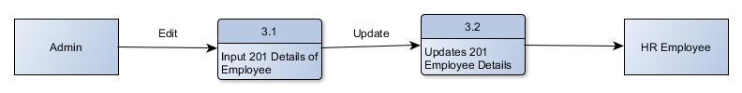
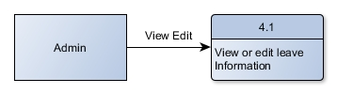
diagrams

Slide 24
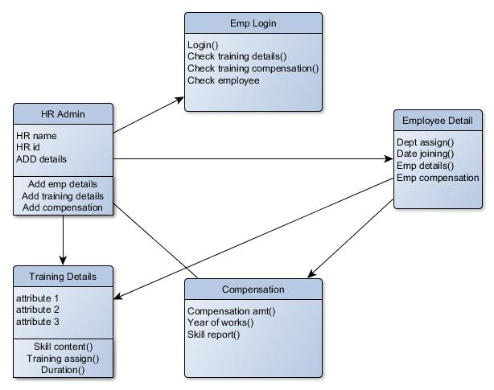
Object Diagram

Slide 25
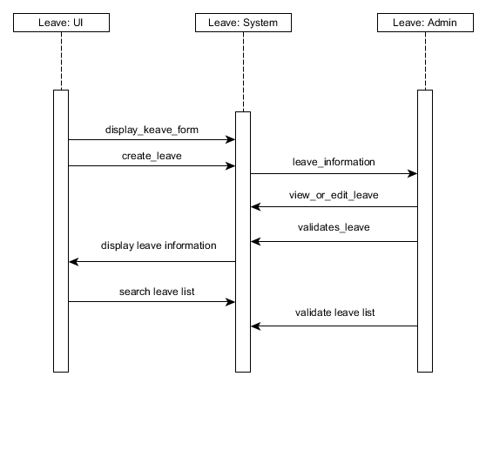
Sequence Diagram

Slide 26
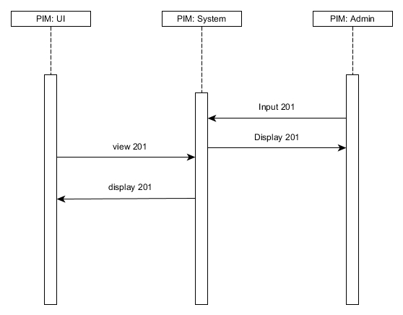
Sequence Diagram

Slide 27
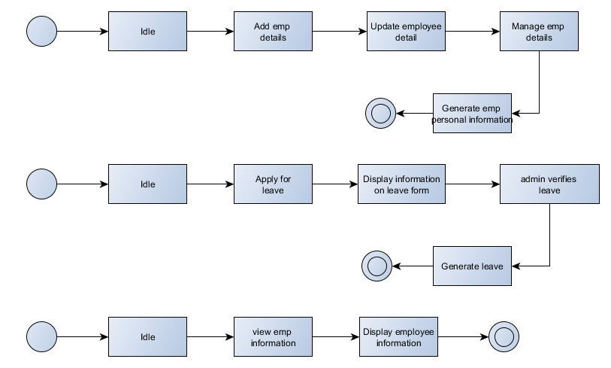
State Diagram

Slide 28
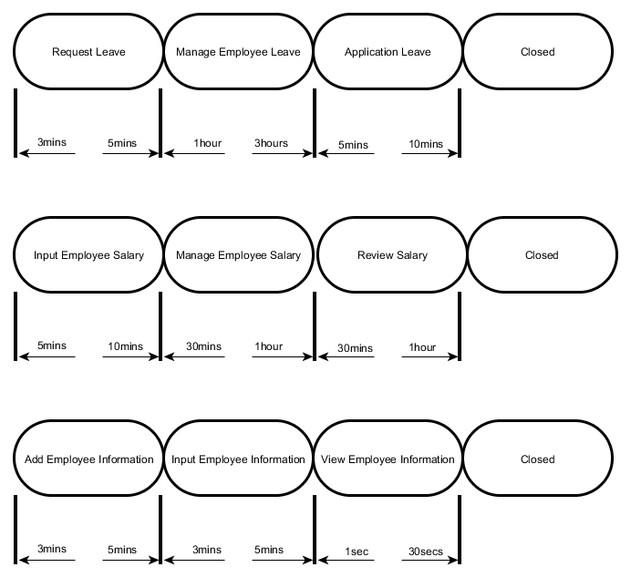
Timing Diagram

Slide 29
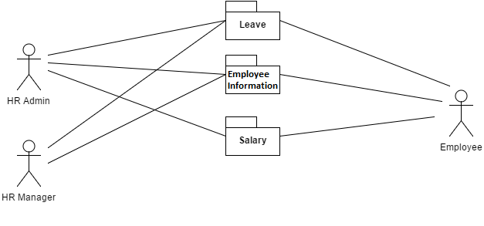
Package Diagram

Slide 30
Deployment diagram

Slide 31
Conclusions and Recommendations

Slide 32
Appendices

